Slide 1
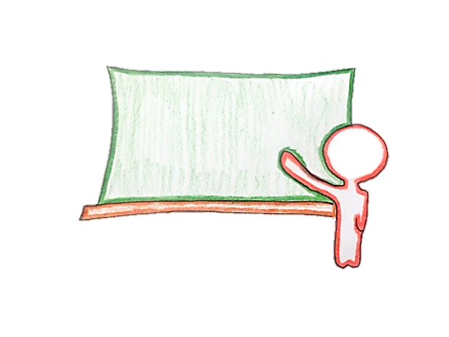
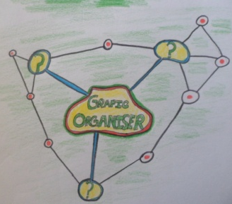
Forestry Industry
Note: Change in arrow colour means change in lesson
2 min presentation on the group work activity
Group Work
Analyses of handout in groups
Graphic organiser based on the rainforest
Summary of the days learning
Reciprocal teaching activity based on the rainforest

Slide 2
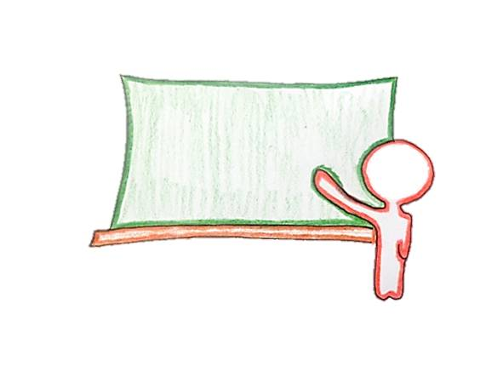
Group work
Students work on planning out their project
Students work on their projects in groups
Students discuss the ideas of their projects they must
Presentation of projects
Merit for the group which presents the best project
Students and teacher provide feedback on the projects

