Slide 1
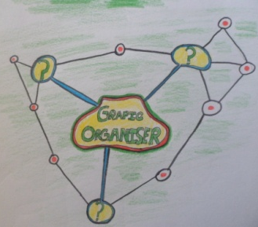
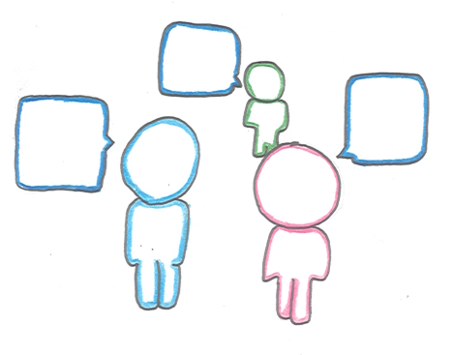
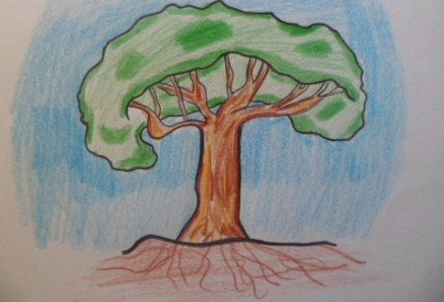
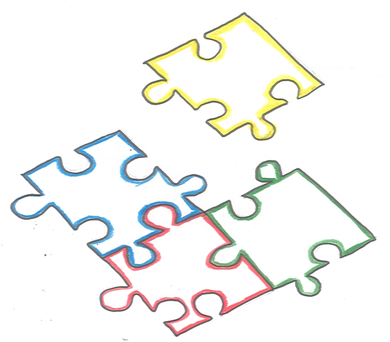
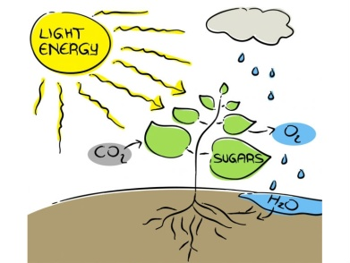
Growth of a Tree
Note: Change in arrow denotes change in
Discussion on how from little acorns great oaks grow
Pair work initially, then whole class discussion on growth of a tree
Group Work
Table quiz
Jigsaw method for teaching
Photosynthesis experiment

Slide 2
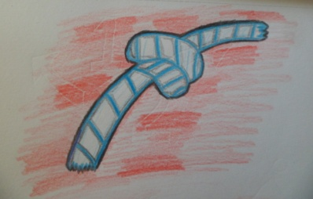
Rope activity
Students draw a tree and explain the key points of the lesson
Table quiz
Jigsaw method for teaching

